Slide 1

Spring of Code
Artificial Intelligence
(Machine Learning & Deep Learning)
Instructor
Asad Ullah
- Research Assistant (DIP Lab)
Duration
03 Months
(Feb – April)

Slide 2

Gated Recurrent Unit (GRU)
Objectives:
Introduction to GRU
Stacked RNNs
Bidirectional RNNs

Slide 3
Unlike LSTM, GRU has only one State and only two Gates
Update Gate and Reset Gate

Slide 4
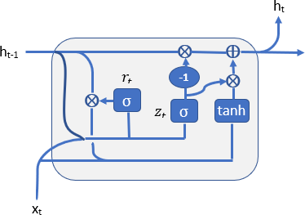
Gated Recurrent Unit (GRU)

Slide 5
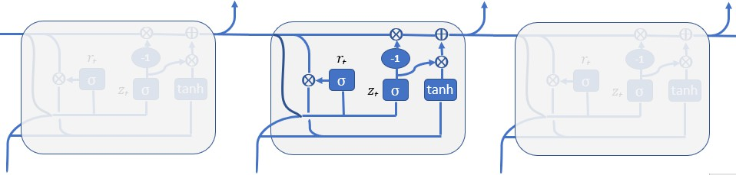
Gated Recurrent Unit (GRU)
^{ℎ}𝑡−1
ℎ_{𝑡}
^{ℎ}𝑡+1
^{ℎ}𝑡−2
^{𝑥}𝑡−1
𝑥_{𝑡}
^{𝑥}𝑡−1

Slide 6
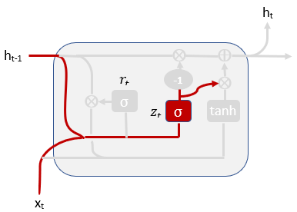
Update Gate
How much of the past information need to be considered to the next time step.
𝑈_{𝑟}
𝑍_{𝑡} = 𝜎 𝑊_{𝑧} ∙ 𝑥_{𝑡} + 𝑈_{𝑧} ∙ ℎ_{𝑡−1}
𝑊_{𝑟}

Slide 7
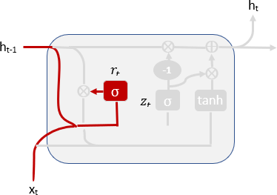
Reset Gate (𝑟_{𝑡})
How much of the past information to be forgotten?
𝑟_{𝑡} = 𝜎 𝑊_{𝑟} ∙ 𝑥_{𝑡} + 𝑈_{𝑟} ∙ ℎ_{𝑡−1}
𝑈_{𝑟}
𝑊_{𝑟}

Slide 8
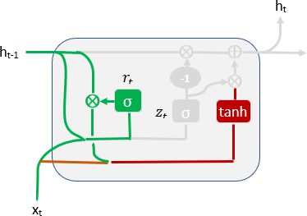
Internal Information (Current Memory Content)
𝑈_{ℎ}
_{ℎ}෨_{𝑡}
_{ℎ}෨
= 𝑡𝑎𝑛ℎ 𝑊_{ℎ} ∙ 𝑥_{𝑡} + 𝑟_{𝑡} ⊗ 𝑈_{ℎ} ∙ ℎ
𝑡
𝑡−1
𝑊_{ℎ}
Consider the present input and useful information of the
previous hidden state to produce new internal information

Slide 9
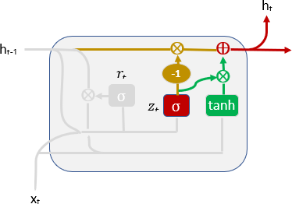
New Hidden State (ℎ_{𝑡})
ℎ_{𝑡} = 1 − 𝑧_{𝑡} ⊗ ℎ_{𝑡−1} ⊕ 𝑧_{𝑡} ⊗ ℎ^{෨}_{𝑡}

Slide 10
New Hidden State (ℎ_{𝑡})
ℎ_{𝑡} = 1 − 𝑧_{𝑡} ⊗ ℎ_{𝑡−1} ⊕ 𝑧_{𝑡} ⊗ ℎ^{෨}_{𝑡}
Previous hidden state at the position which are ignored in internal information
Useful information from the internal information

Slide 11
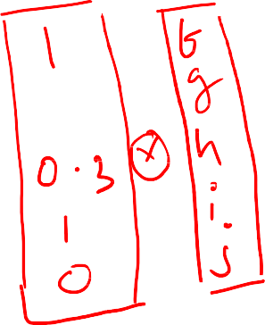
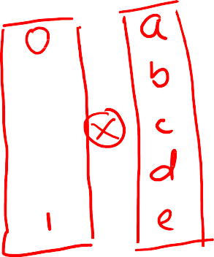




New Hidden State (ℎ_{𝑡})
ℎ_{𝑡} = 1 − 𝑧_{𝑡} ⊗ ℎ_{𝑡−1} ⊕ 𝑧_{𝑡} ⊗ ℎ^{෨}_{𝑡}

Slide 12
Summary
One State
Hidden State ℎ𝑡 =
1 − 𝑧_{𝑡} ⊗ ℎ_{𝑡−1} ⊕ 𝑧_{𝑡} ⊗ ℎ^{෨}_{𝑡}
Two Gates
•
•
Update Gate 𝑍_{𝑡} = 𝜎 𝑊_{𝑧} ∙ 𝑥_{𝑡} + 𝑈_{𝑧} ∙ ℎ_{𝑡−1}
Reset Gate 𝑟_{𝑡} = 𝜎 𝑊_{𝑟} ∙ 𝑥_{𝑡} + 𝑈_{𝑟} ∙ ℎ_{𝑡−1}

Slide 13
Thank You

